Slide 1
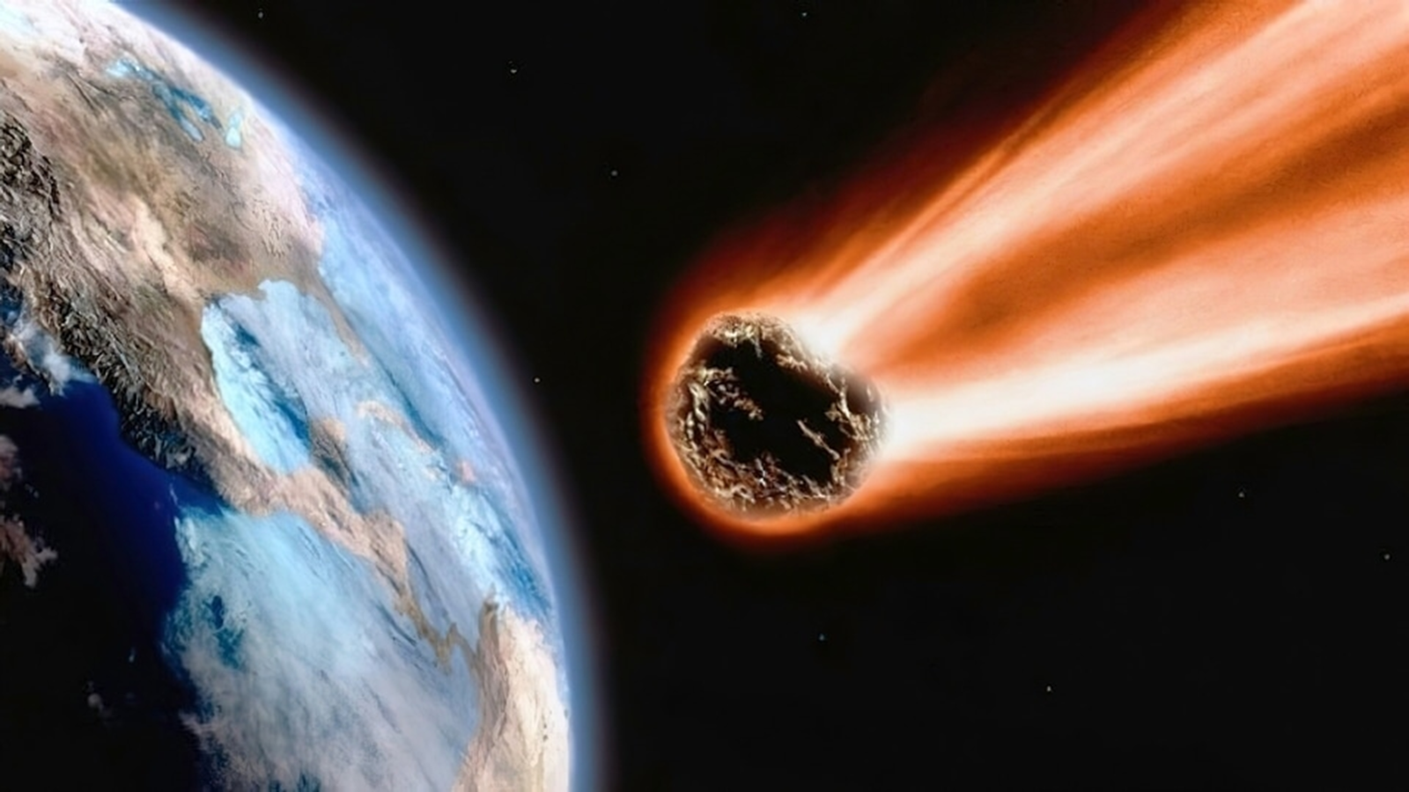
Meteorite Data Analysis
E. Baldwin

Slide 2
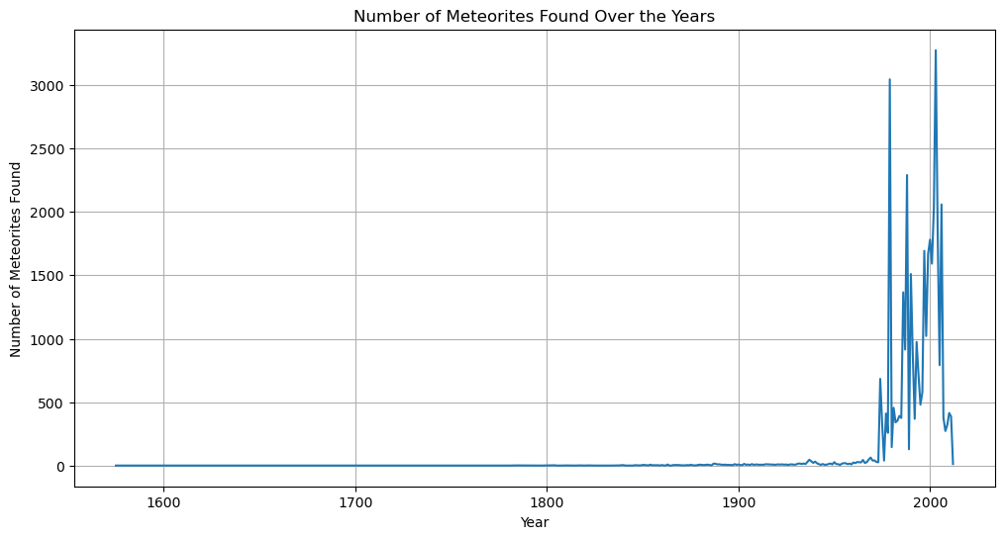

Slide 3
Title

Slide 4
Title

Slide 5
Title

Slide 6
Title

Slide 7
Title

